Slide 1


Global Terrorism (Part 1 of 2)
Josh Gardner
DSC 680 Applied Data Science

Slide 2

Problem Statement
Different terroristic attacks, being perpetrated by different groups, occur around the world year after year.
Source
Basra, R., Crawford, B., Keen, F. (10 Oct. 2019) Time. “How the synagogue shooting in Germany fits into a global pattern of far-right terrorism.” Retrieved 11 Oct. 2019 from https://time.com/5697553/halle-germany-synagogue-christchurch-terrorism/

Slide 3
Research Questions
How does a region’s instability influence the rates of terrorism?
Does strengthening a region’s stability lower the terrorism rate of that region?
How can the different acts of terror be grouped together? Can anything be inferred by how the terroristic acts are grouped?
Does one region’s terrorism cluster influence another region’s cluster? Specifically, how does the terrorism cluster influence non-adjacent clusters?

Slide 4
Where Data was Gathered From
The data was gathered from the Integrated Network for Societal Conflict Research and the RAND Database of World Terror Incidents.

Slide 5
Analysis Plan
Explore the data
Explore how the different datasets relate to each other
Run k-Means Clustering on the different groupings within the data
Analyze the different clusters

Slide 6
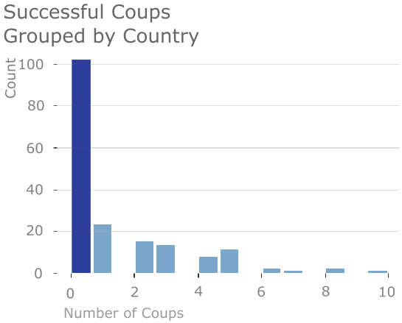
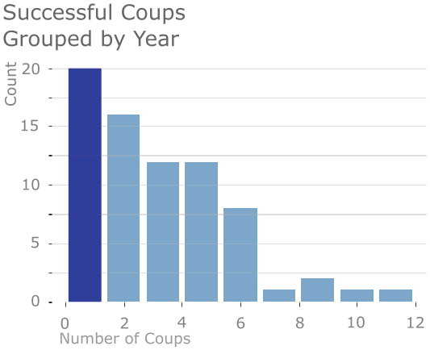
Exploring Coups
By country:
Most countries do not experience successful coups.
A handful of countries experience large number of coups
By year:
There are not many coups per year around the world

Slide 7
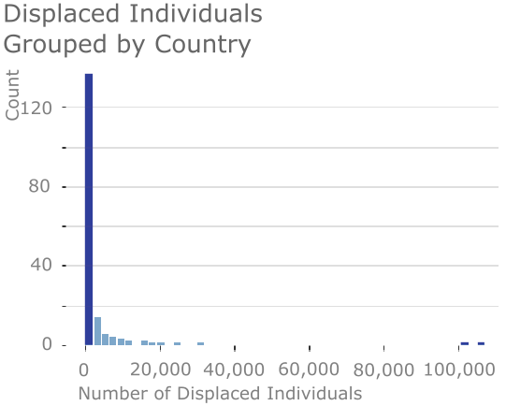
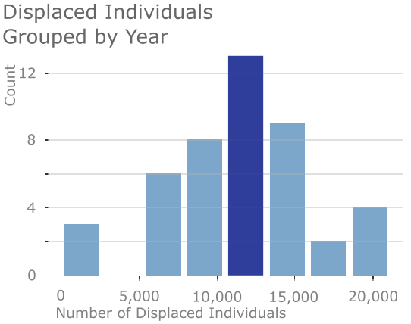
Exploring Individuals Displaced From Their Home Countries
Grouped by Country
Most countries do not generate a displaced individuals.
Grouped by Year
Year by year, there is a normal distribution of how many people are displaced from their home country.

Slide 8
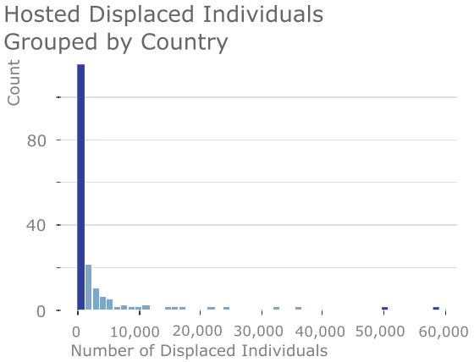
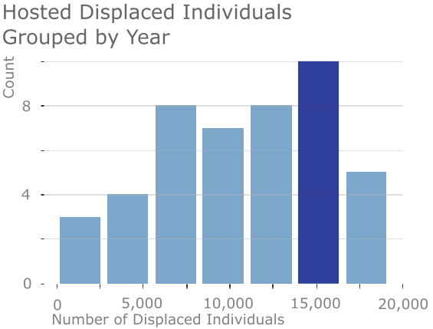
Exploring Displaced Individuals’ New Home Country
Grouped by Country
Most countries do not host, or accept, displaced individuals.
On the other hand, there are those countries that do accept large numbers of displaced individuals.
Grouped by Year
There is a normal distribution of the number of displaced individuals who are accepted into other countries.

Slide 9
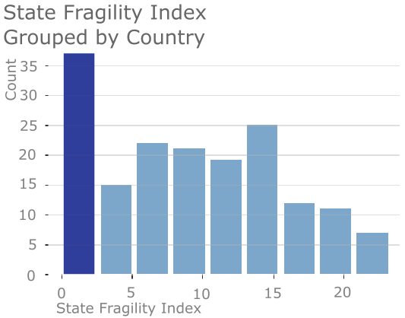
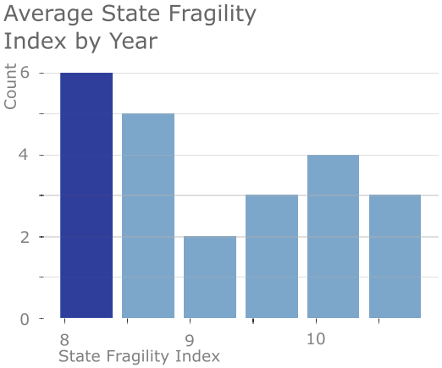
Exploring the State Fragility Index
Grouped by Country
Most countries are stable.
Grouped by Year
The average State Fragility Index for the world changes over the years and ranges from 8 to 11.

Slide 10
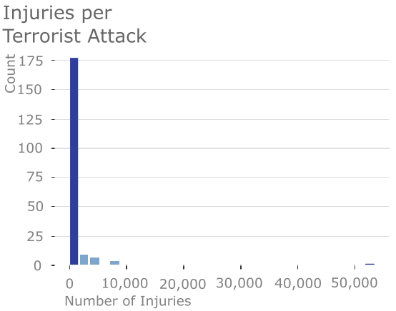
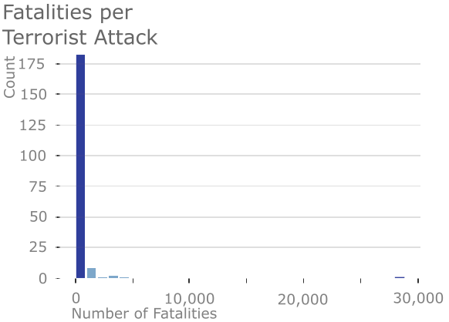
Exploring RAND
Most terrorist attacks result in low numbers of fatalities and injuries
There are a handful of attacks that result in high numbers of fatalities and injuries

Slide 11
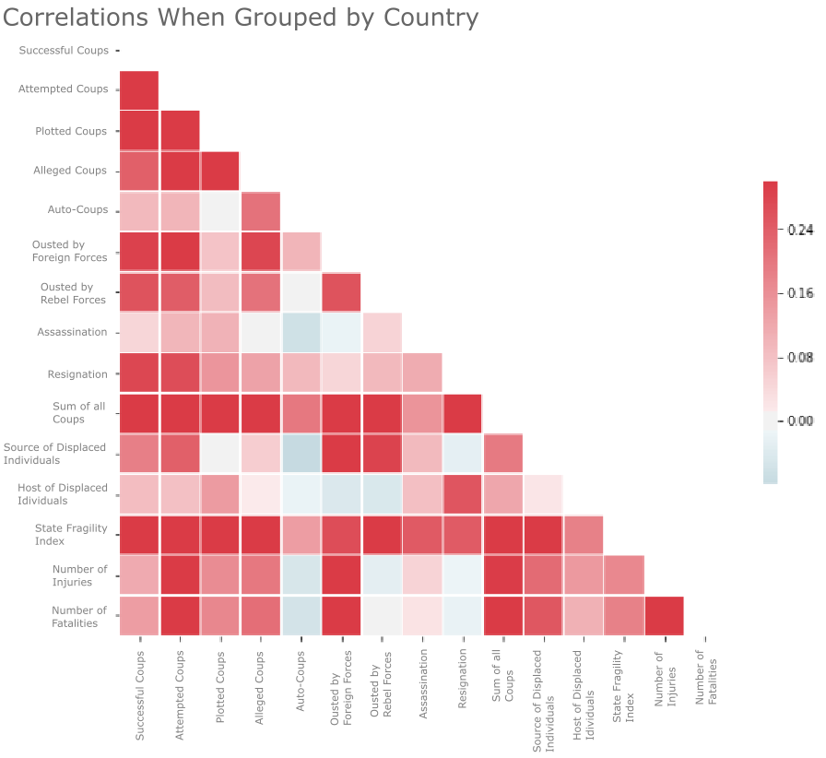
What Are the Correlations
State Fragility Index is moderately, positively correlated with most of the other variables.

Slide 12
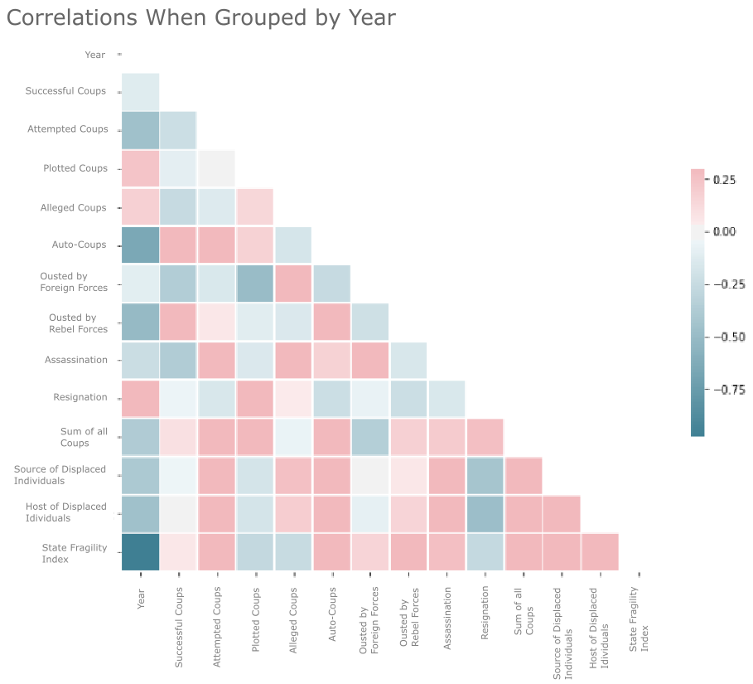
What Are the Correlations
The year is negatively correlated with most of the other variables. This implies that as time goes on, the amount of terrorism is decreasing.

